Slide 1
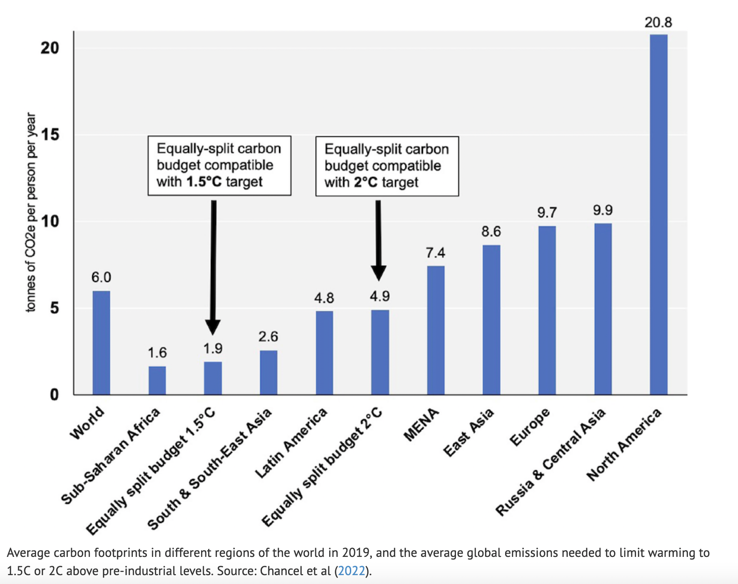
Chancel, 2022: Per-capita budgets needed to avoid 2 degrees warming

Slide 2
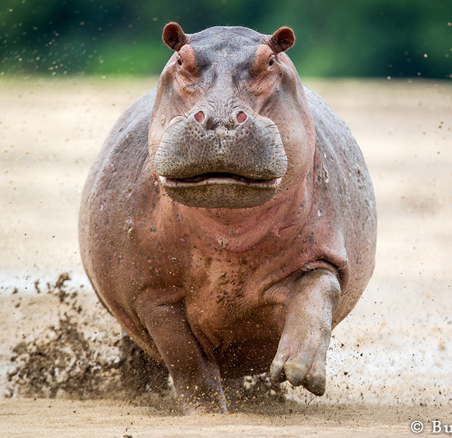
Chancel, 2022: Per-capita budgets needed to avoid 2 degrees warming

Slide 3
Chancel, 2022: Per-capita budgets needed to avoid 2 degrees warming
16 GtC/yr

Slide 4
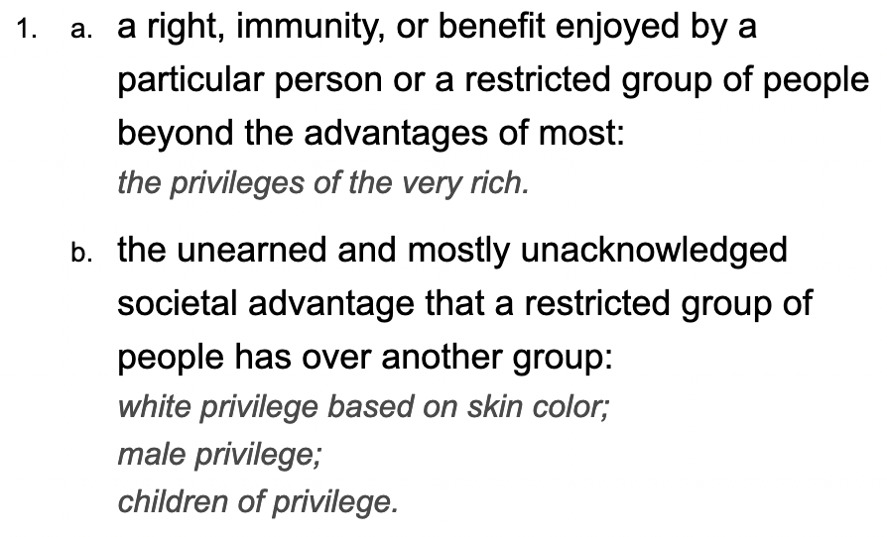
“Carbon Privilege” would seem to be an appropriate term for this
Dictionary.com
My lifetime carbon emissions due to flying.

Slide 5
Chancel, 2022: Per-capita budgets needed to avoid 2 degrees warming
Carbon Privilege = 16 tC/yr

Slide 6
A “what if I cut back?” perspective on our agency
Cut back on Flying (1/5)
Cut back on driving (1/5)
Eat less beef

Slide 7
An “abolitionist” perspective on our agency
Don’t even like beef
Let’s zoom (1/5)
Why should fly? (1/5)

Slide 8
What’s stopping us from exercising our climate mitigation agency?
Don’t even like beef
Let’s zoom (1/5)
Why should fly? (1/5)
Maybe we don’t know how to talk about it effectively.

